Slide 1
Visualizing Collections of Internet Archives
John Berlin, Joel Rodriguez, Slobodan Milanko

Slide 2


Motivation
Current solutions are limiting; small focus
Archivers are unable to visually experience
their collections
Lack of URI evolution
Lack of comparison
User driven, clutter free, design for moderate collections
Archivers desire to visually share collections with each other

Slide 3
Dataset Description
We're abstracting the user's archive collection as a table
Key attribute (URI) that map to categorical or
quantitative values
Archiver - Categorical
Tags - Categorical
Number of archives - Quantitative
URI-M - Categorical
The table approach
Facilitates ordering
Filtering of data

Slide 4
Abstract Tasks
Lookup, browse, explore and locate can be achieved easily
with the table abstraction, and give meaning to the story
Users will be able to identify, compare and summarize
different archive records, and their stories
Analysis through discovery, presentation, and enjoyment

Slide 5

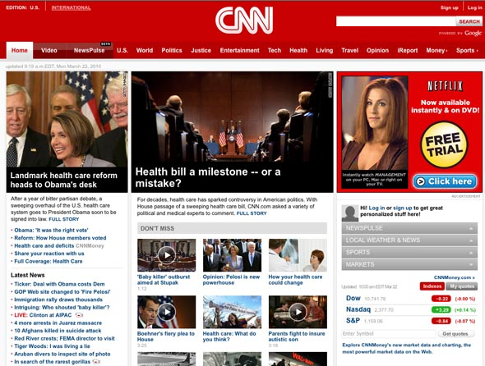

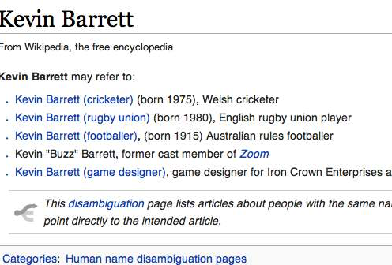
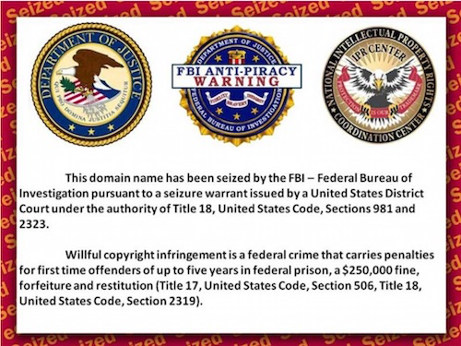
Potential Design

Slide 6
User Driven Control
FILTER
Selection
Group
Criteria
Filter and drill
down by desired
precision
CATEGORY
Date
Tags
URI-M

Slide 7
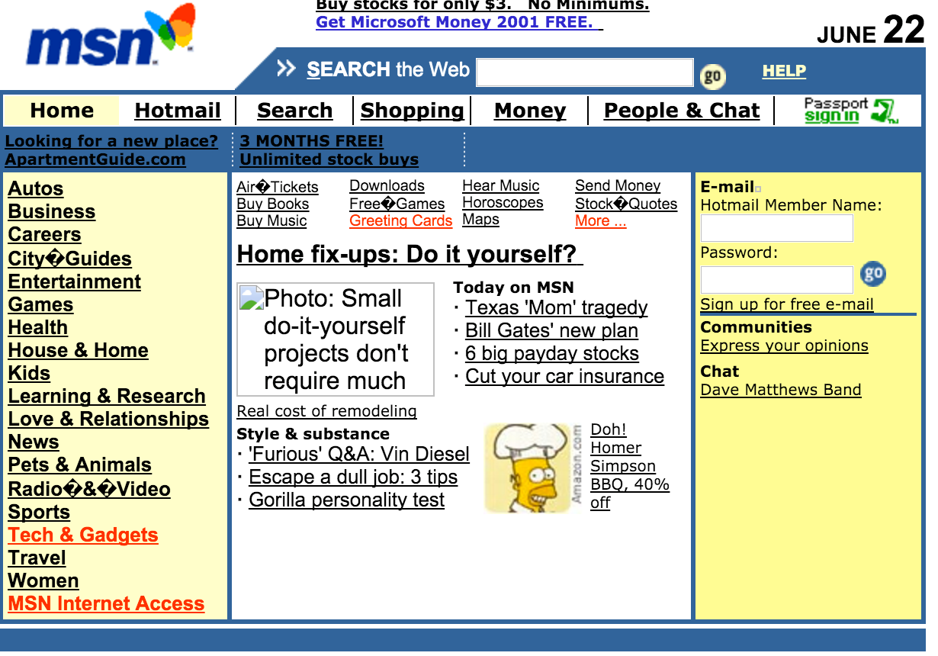


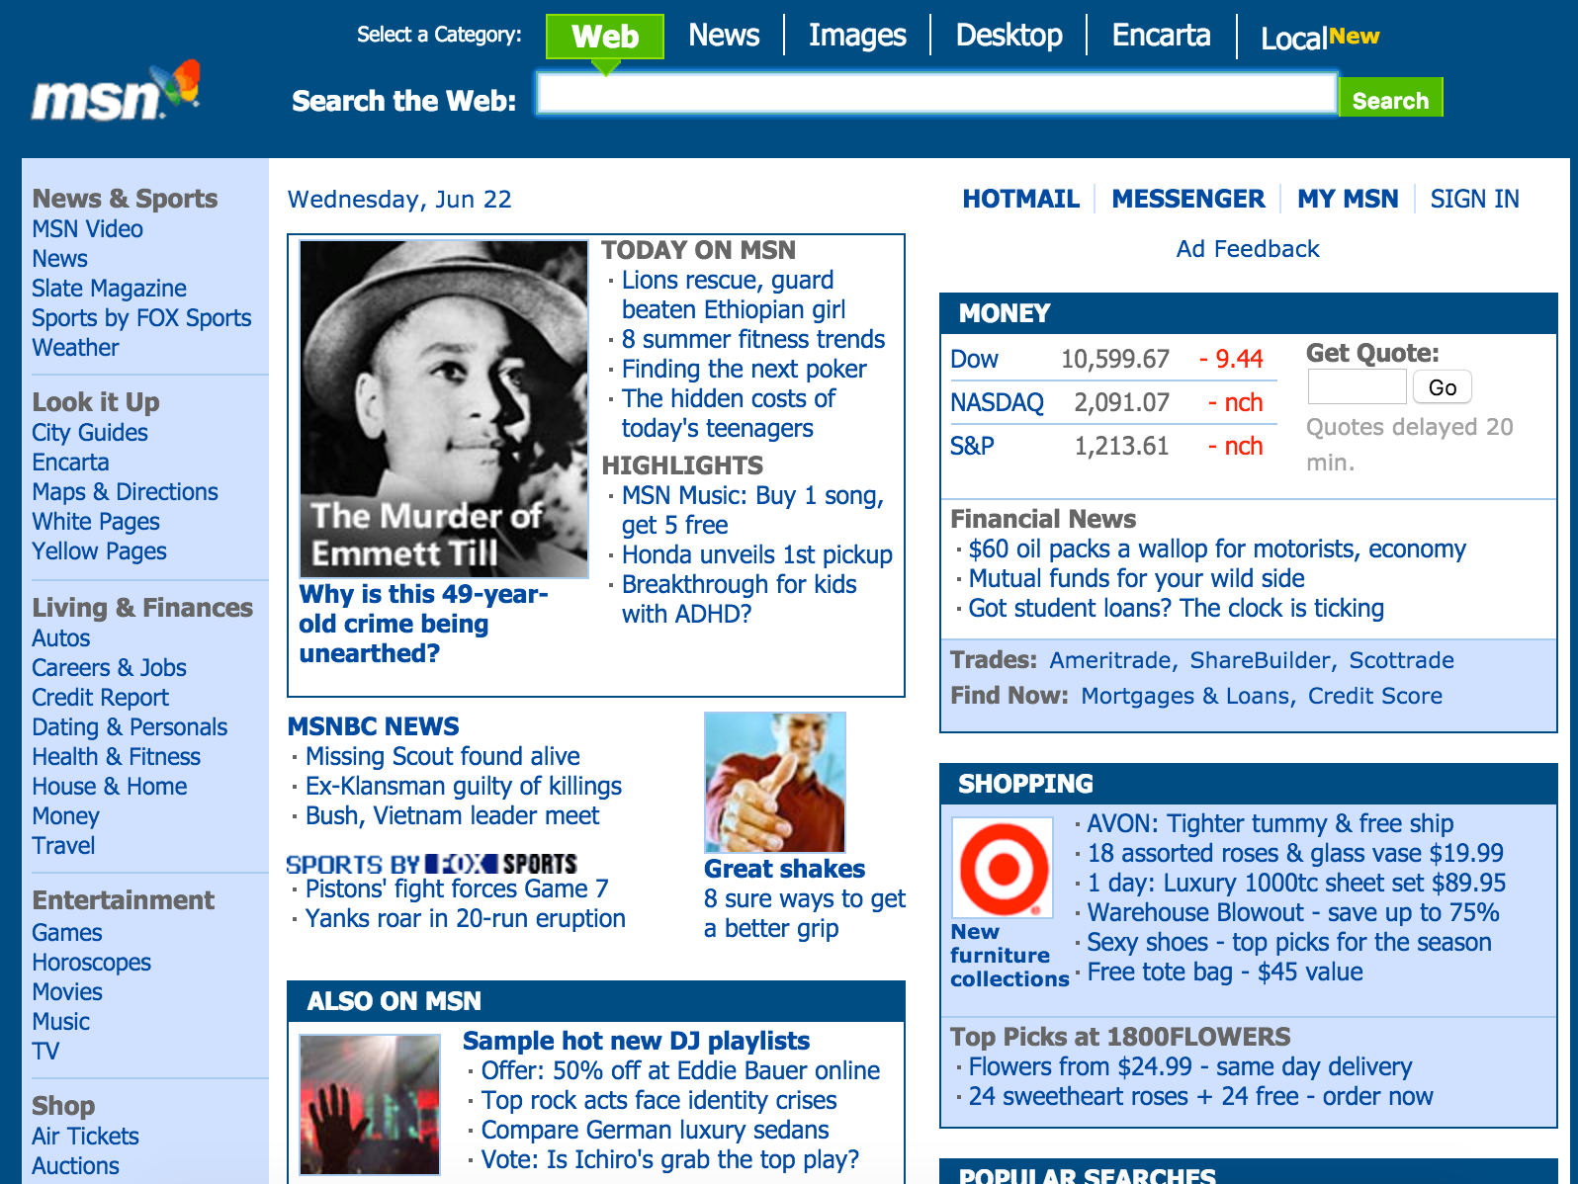
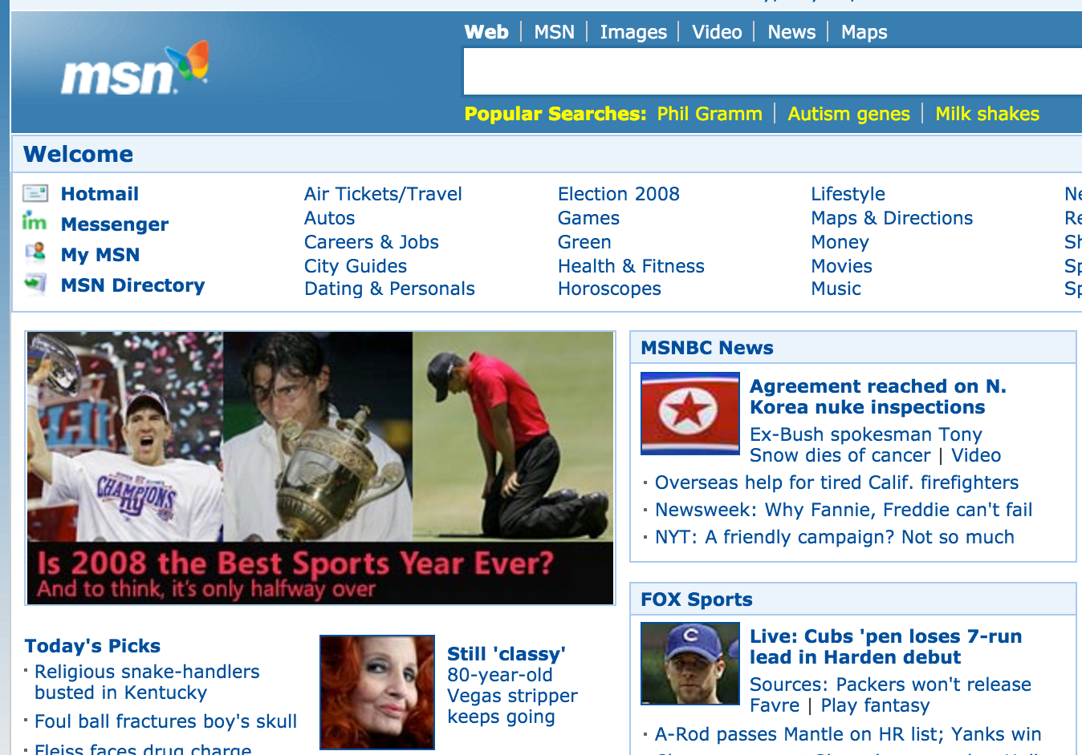
Detail
www.msn.com/news/june
June 22, 2001
BACK
www.msn.com/news/june
June 22, 2005
www.msn.com/news/may
May 22, 2005

Slide 8
Needed Tools
Mink, WARCreate
Create sample archives for local testing
Wayback Machine (Local/Remote)
Get an understanding for look of archives
WAIL
Local archiving and hosting
PhantomJS (snapshots) and D3

Slide 9
Group Roles
Entire Group
Code - Develop a working product
Test - Ensure visualization accepts dynamic data
Survey for feedback
Create demo
Dan & Joel
Create final presentation
John
Final presenter of solution

Slide 10
Estimation
4-6 weeks to develop
1 week to demo and test
Weekly feedback to ensure satisfaction

